Slide 1
Starter
Which of the letters in the alphabet have lines of symmetry? How many?
What is the ‘value’ of your name?
A B C D E F G H I J K L M N O P Q R S T U V W X Y Z
A B C D E F G H I J K L M N O P Q R S T U V W X Y Z

Slide 2
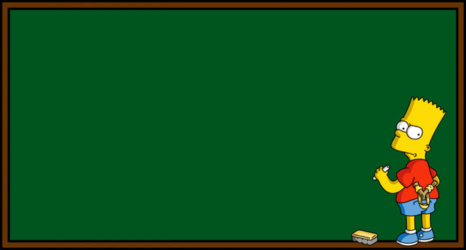
Reflection
Level 5
07/12/2017
Learning Objectives:
Able to reflect shapes in a horizontal or vertical mirror line
Able to reflect shapes in a diagonal
mirror line

Slide 3
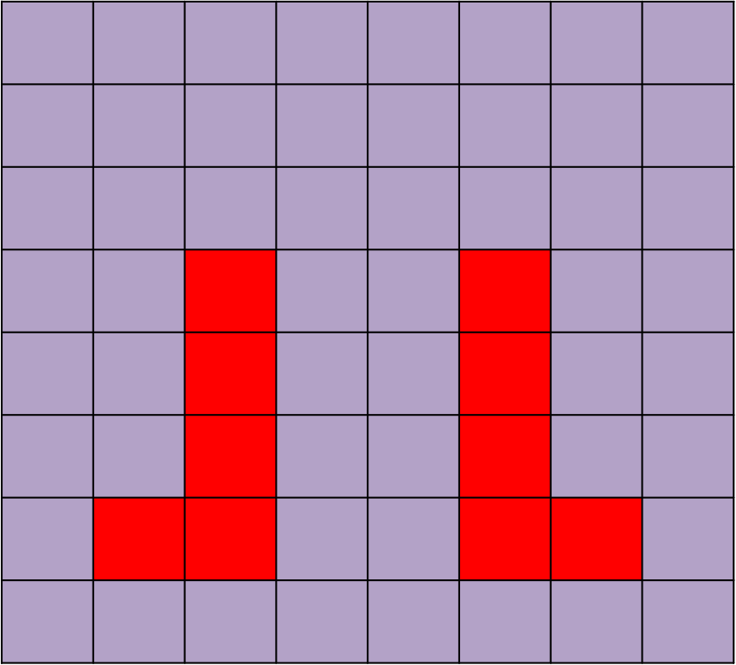
Topic: Reflection
EQ: How do we reflect shapes over a line of symmetry
When reflecting images in a mirror line, each point must be the same distance away from the mirror line on each side
Points are reflect at right angles to the mirror line

Slide 5
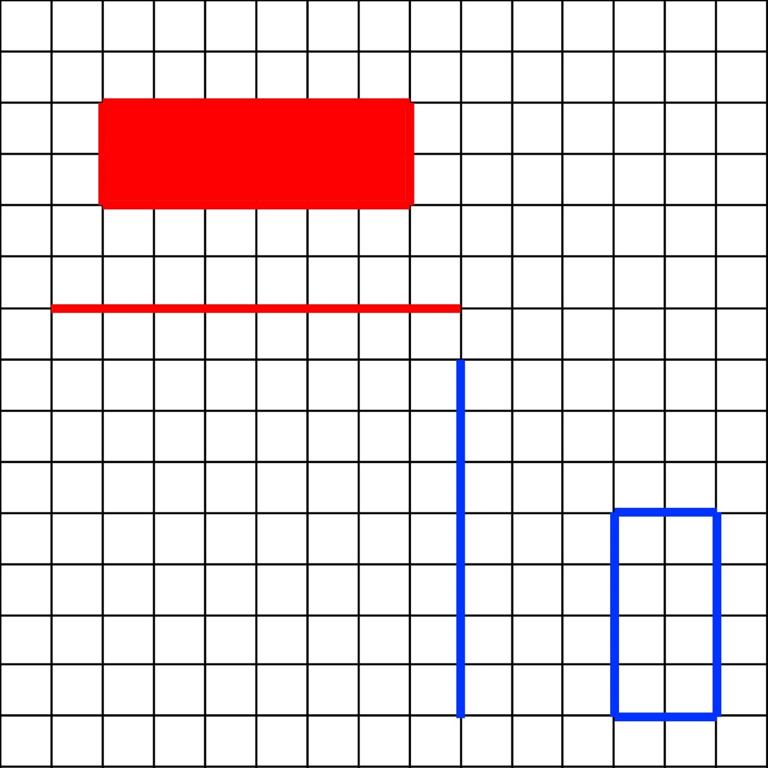
What letter would you get if you reflected each shape in its corresponding mirror line?

Slide 6
What letter would you get if you reflected each shape in its corresponding mirror line?

Slide 7
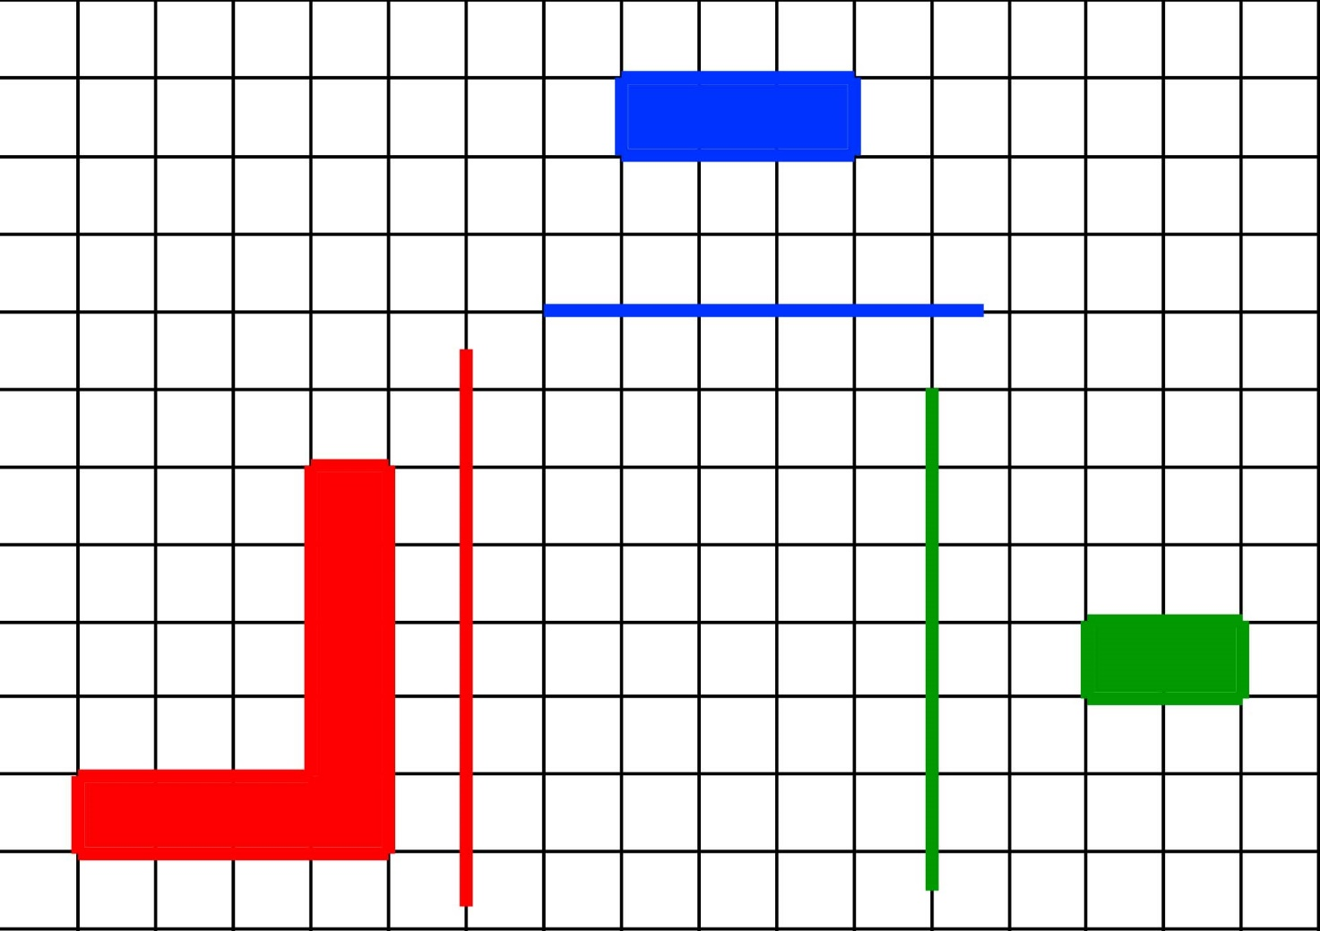
What letter would you get if you reflected each shape in its corresponding mirror line?

Slide 8
What letter would you get if you reflected each shape in its corresponding mirror line?

Slide 9
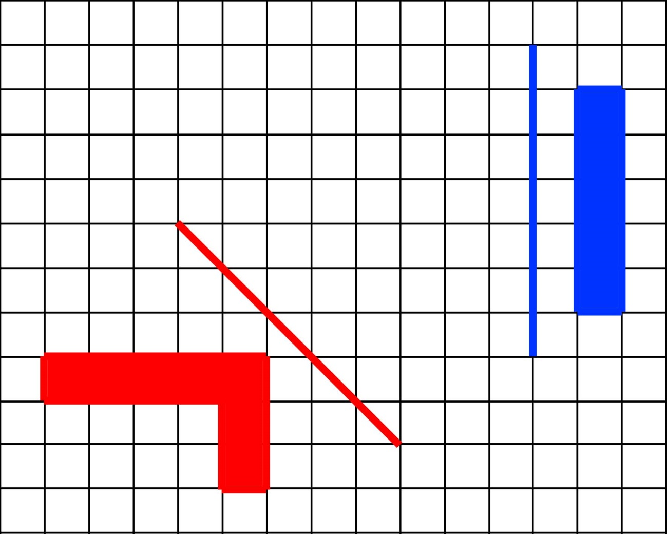
What letter would you get if you reflected each shape in its corresponding mirror line?

Slide 10
What letter would you get if you reflected each shape in its corresponding mirror line?

Slide 11
Now it’s your turn…
On your worksheet, reflect every shape in the corresponding mirror line.
Use tracing paper to help you.
All the shapes should fit together to form a word.
Draw in pencil in case you make any mistakes.

Slide 12
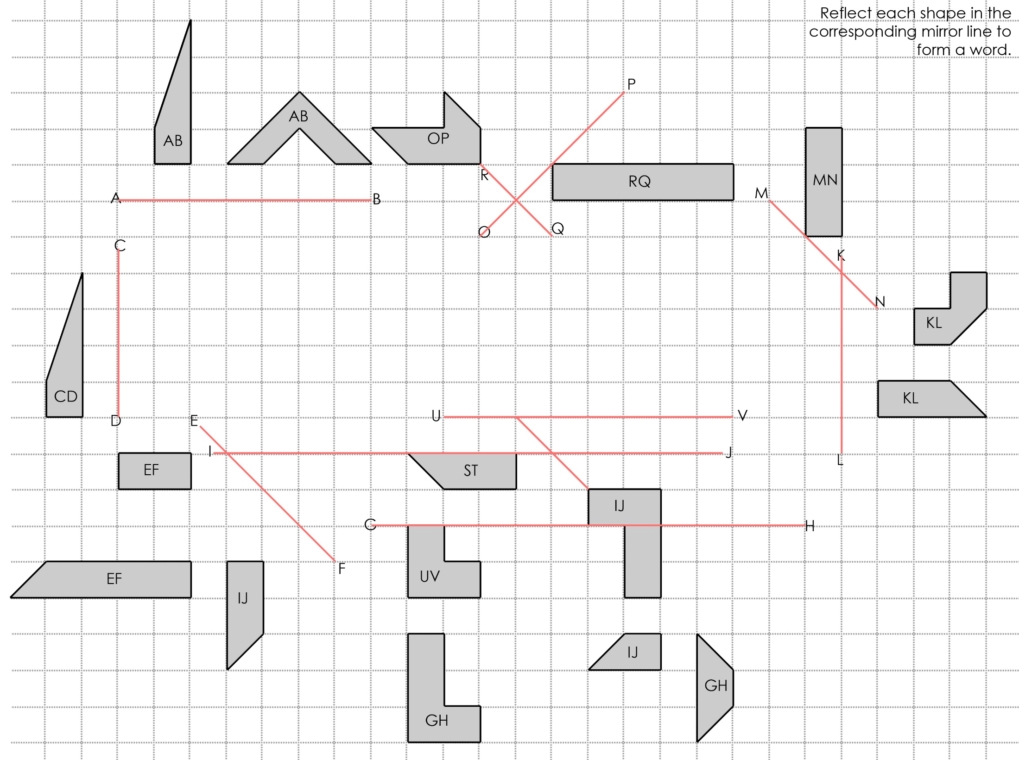
e.g.

Slide 13
Reflection
Reflect each shape in the associated mirror line (indicated by the relevant letters) to spell out a key word in the centre

